Slide 1

Expressed Exome Capture Sequencing: a method for cost-effective exome sequencing for all organisms
B @ G⁴
i
o
i
n
for
o
r
m
a
t
i
c
s
d
a
p
t
a
t
i
o
n
e
n
o
m
i
c
s
Jonathan B. Puritz
University of Rhode Island
Kathleen E. Lotterhos
Northeastern University

Slide 2

Which genes are under selection?
T₀
T₁
B@G 2018

Slide 3
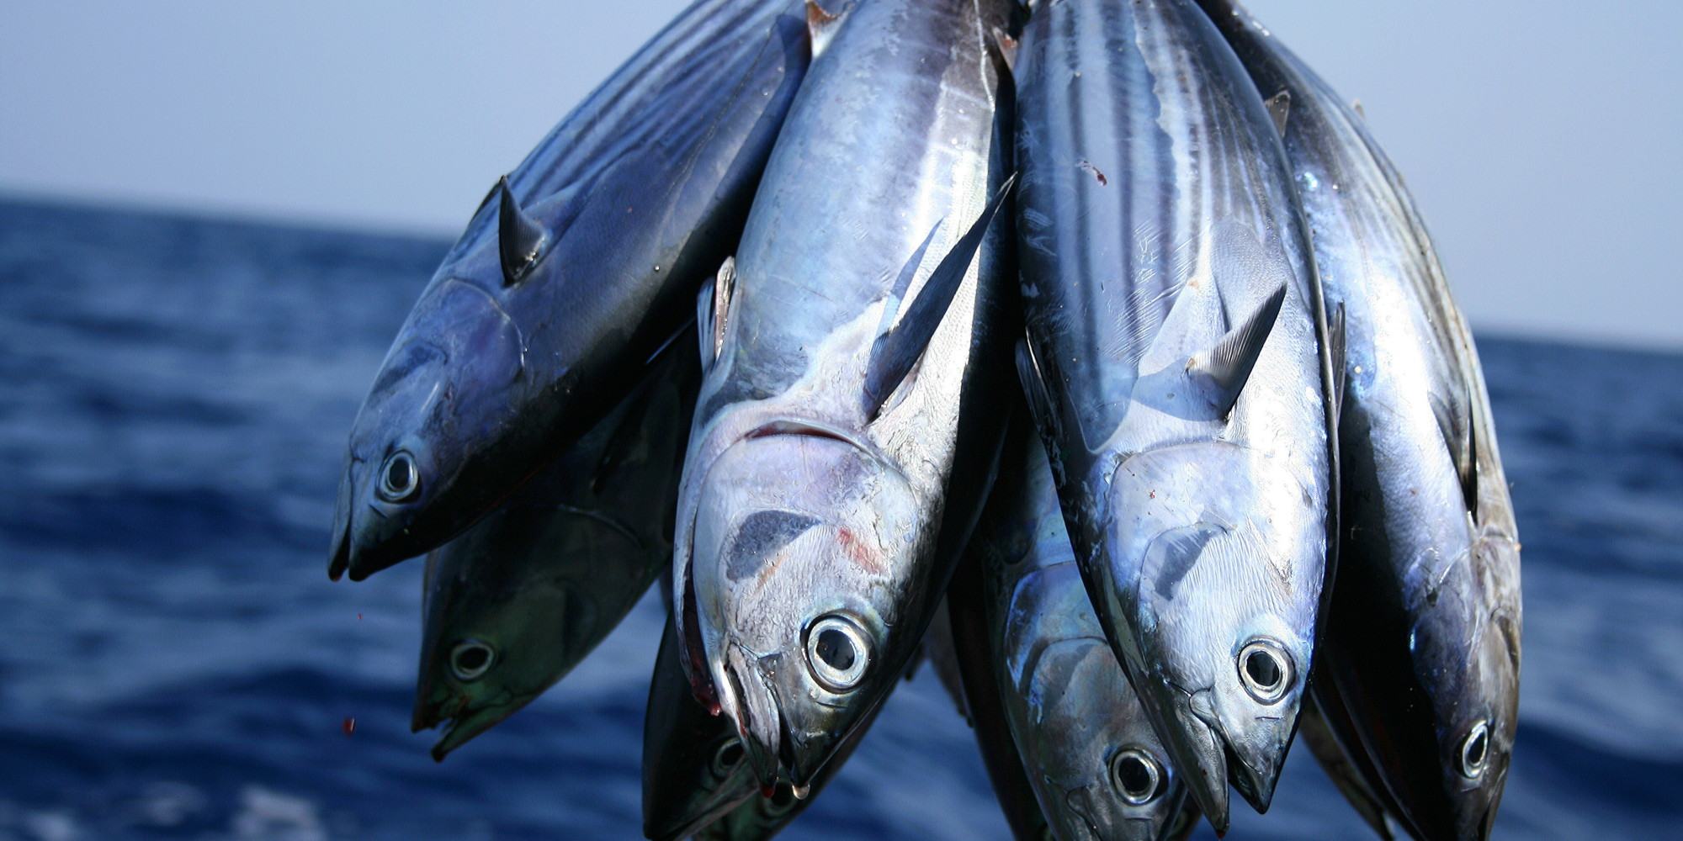
Evolutionary trajectory of species/populations
For population level inference, genome reduction is needed.
B@G 2018

Slide 4
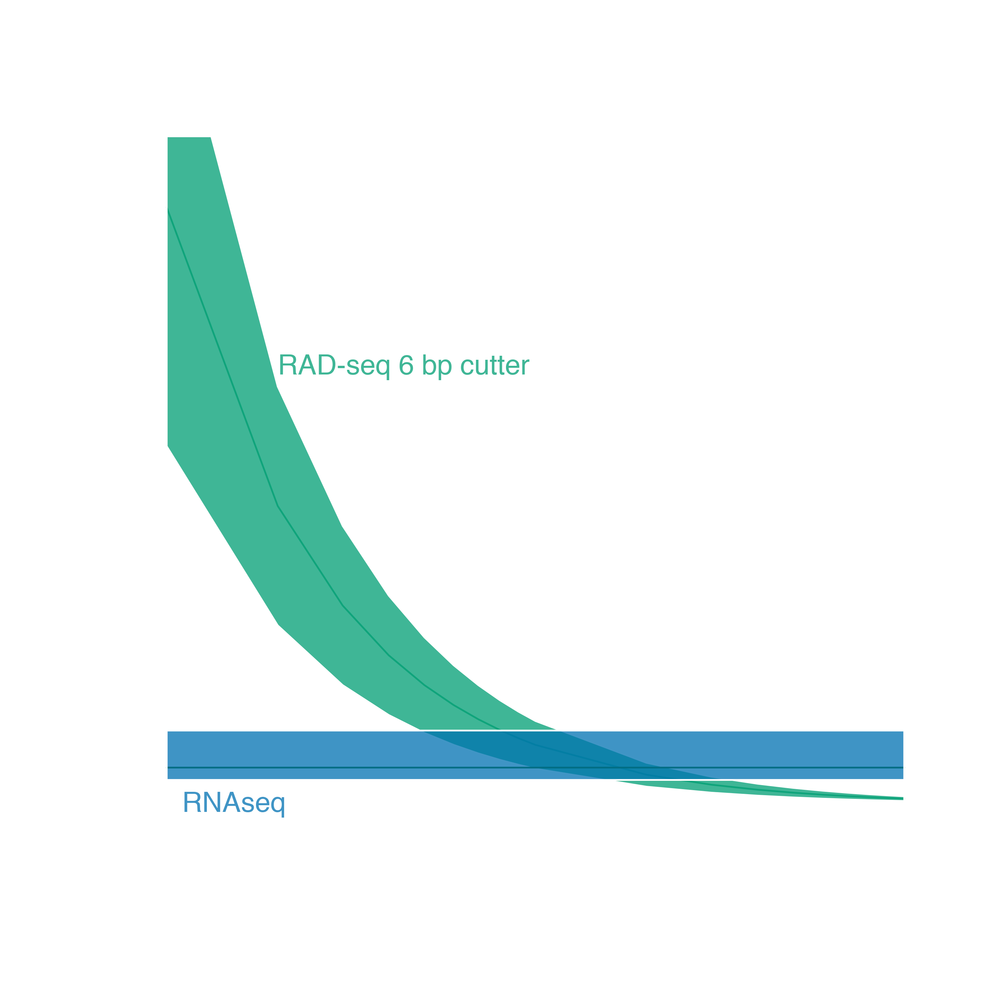

Genome reduction options
No existing genomic resources
RNAseq
Relatively expensive
Allele specific expression
RADseq
Depending on linkage block size and number of loci, target genes may not be sampled
Adapted from Lowry et al. 2016
B@G 2018

Slide 5
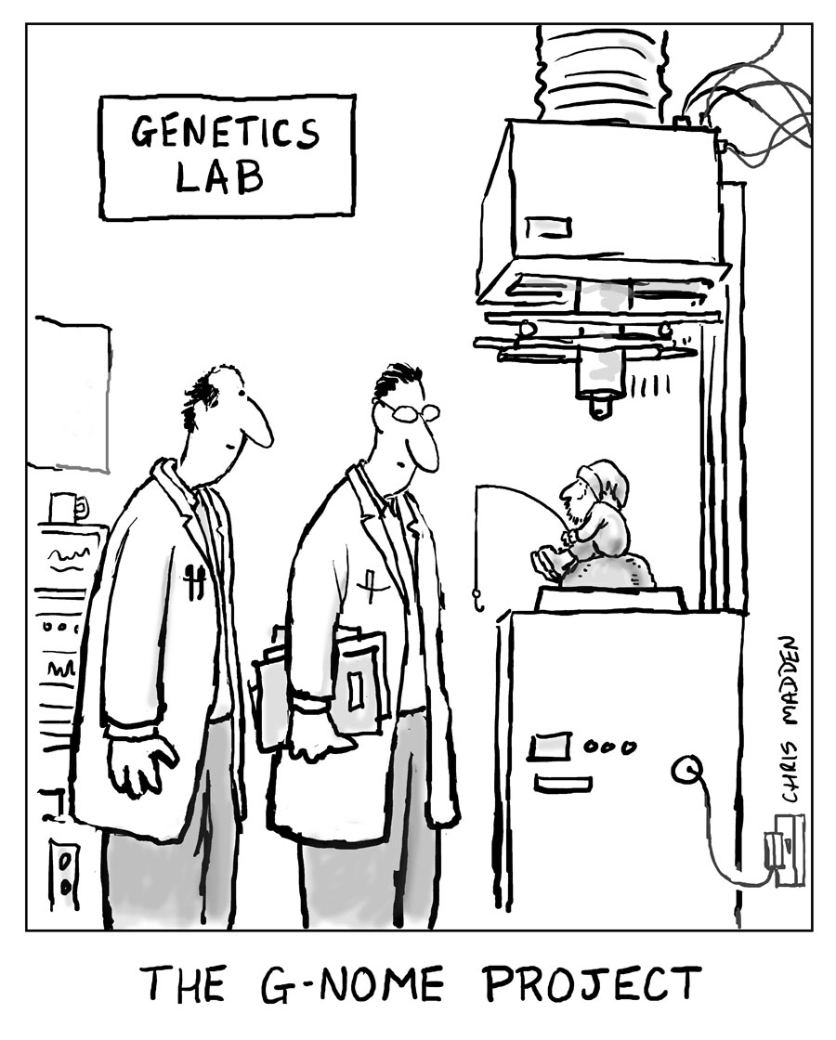
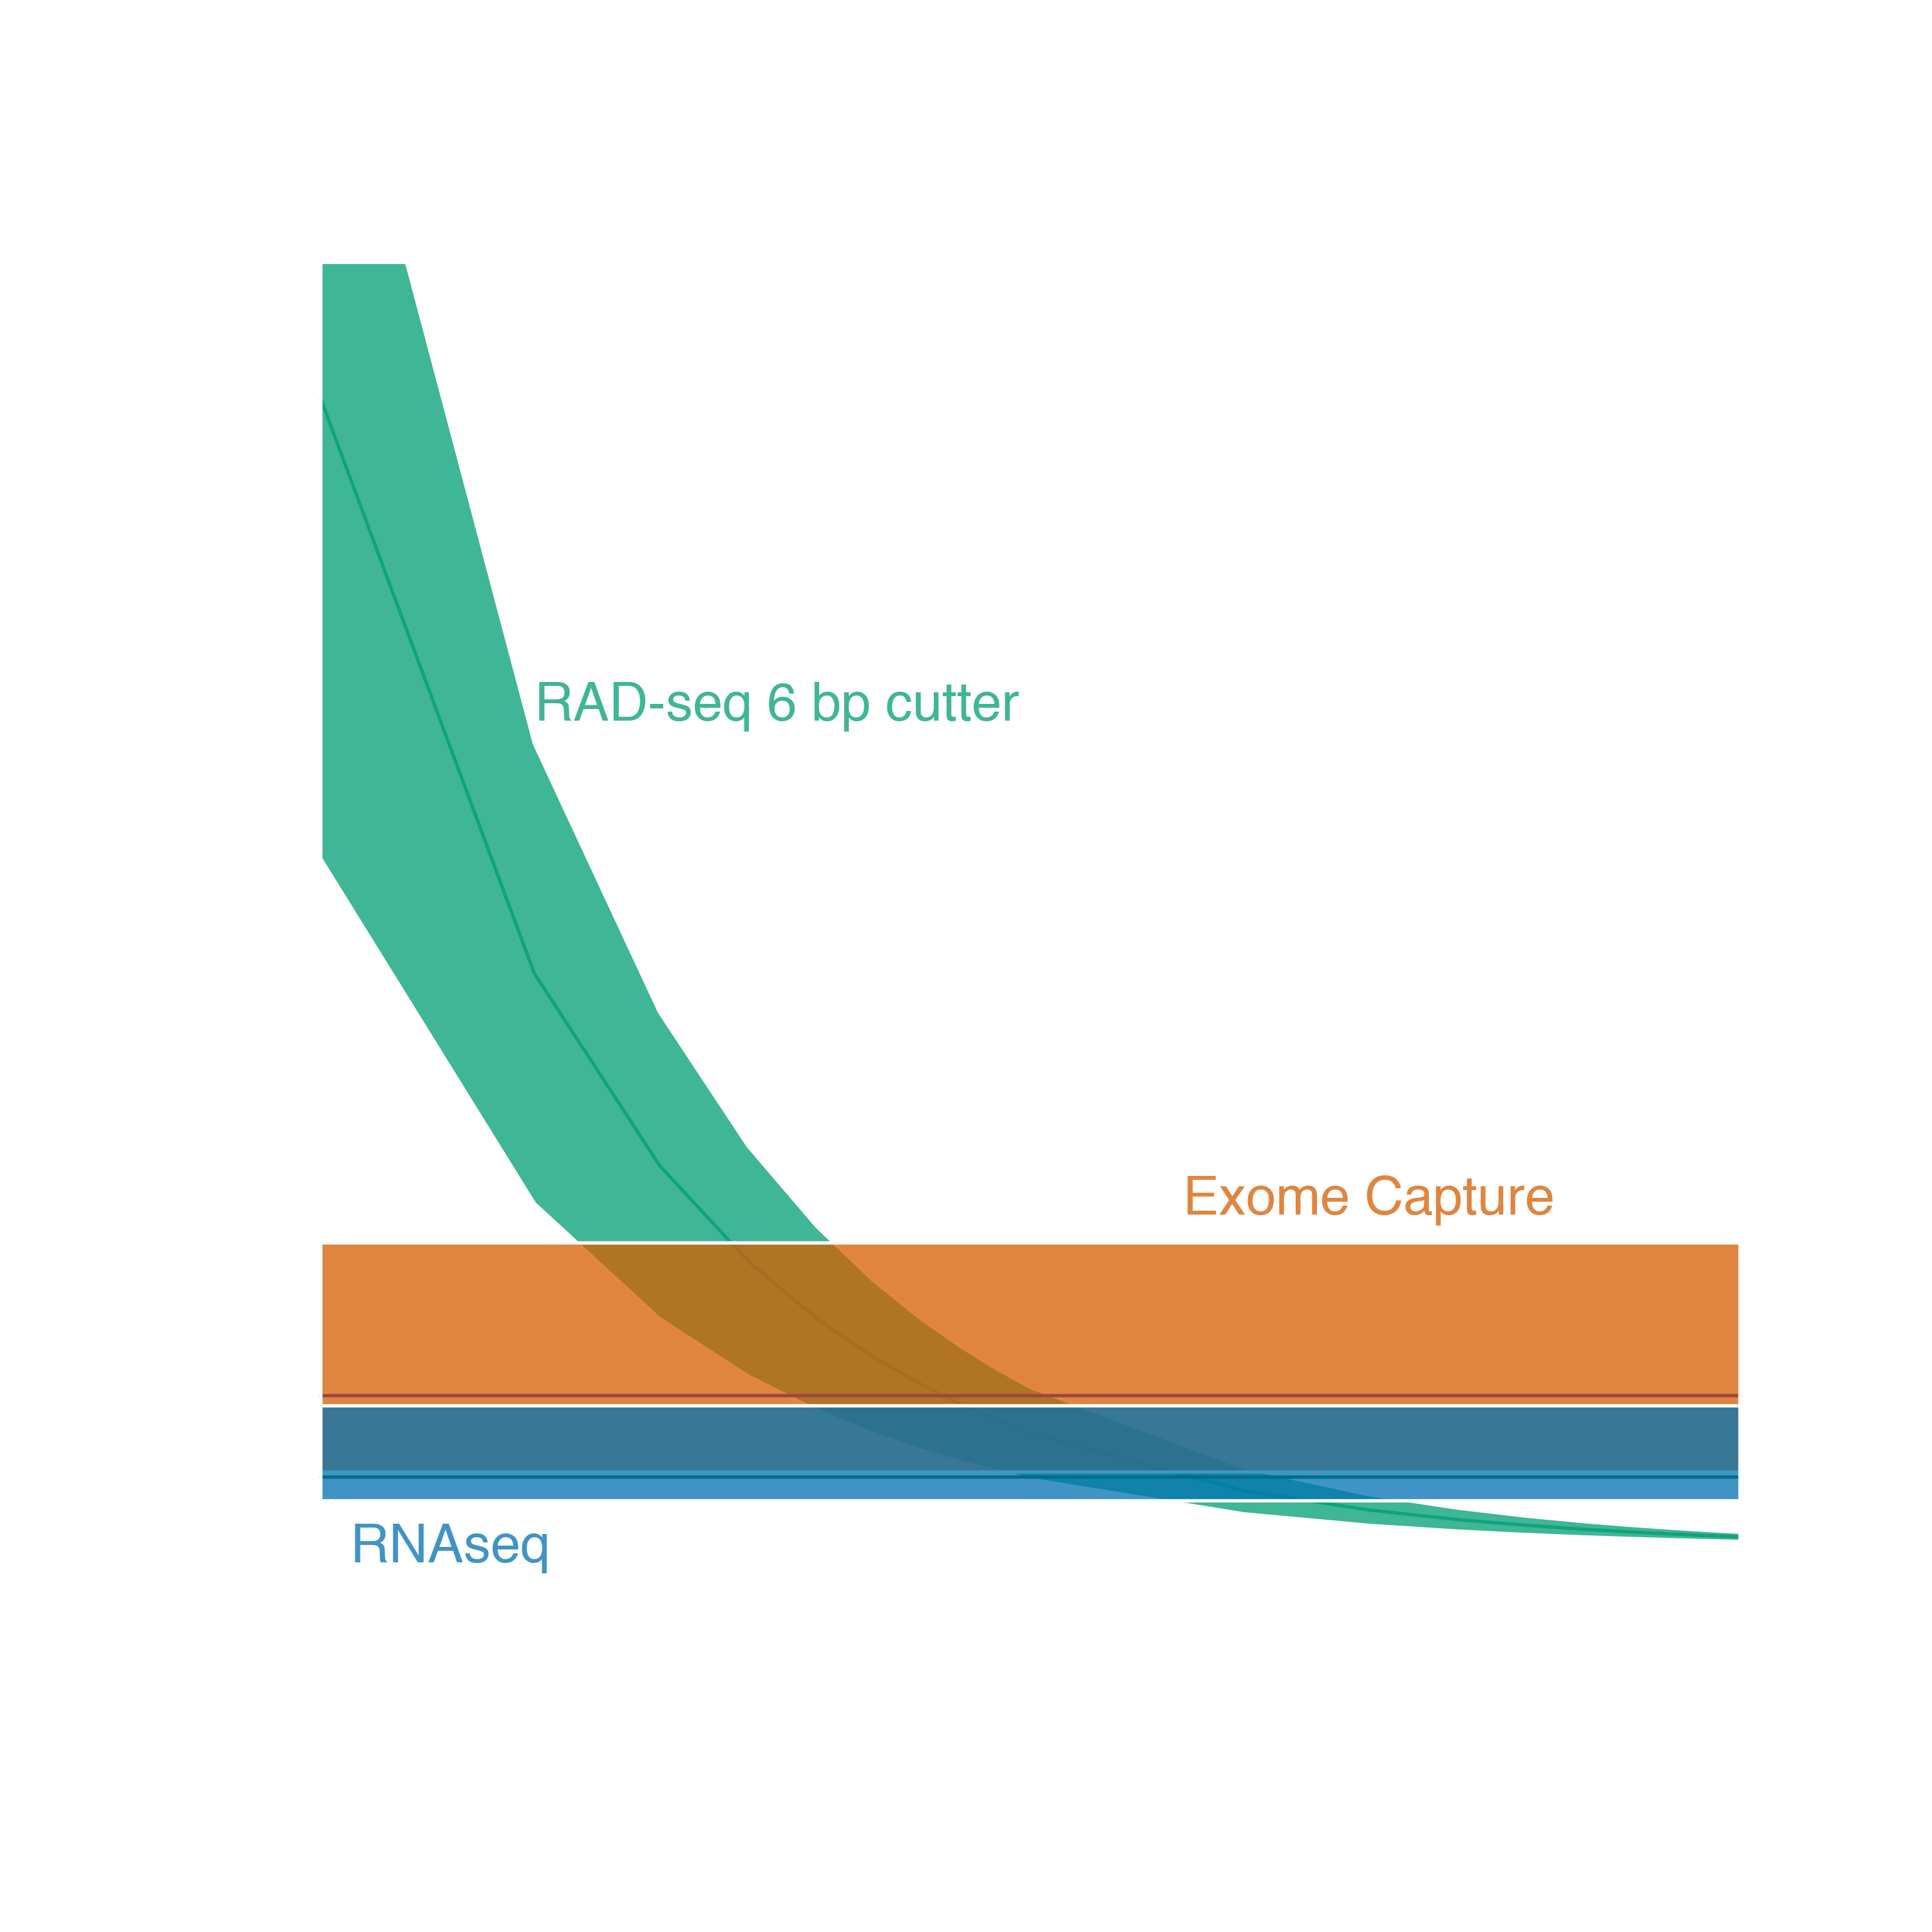
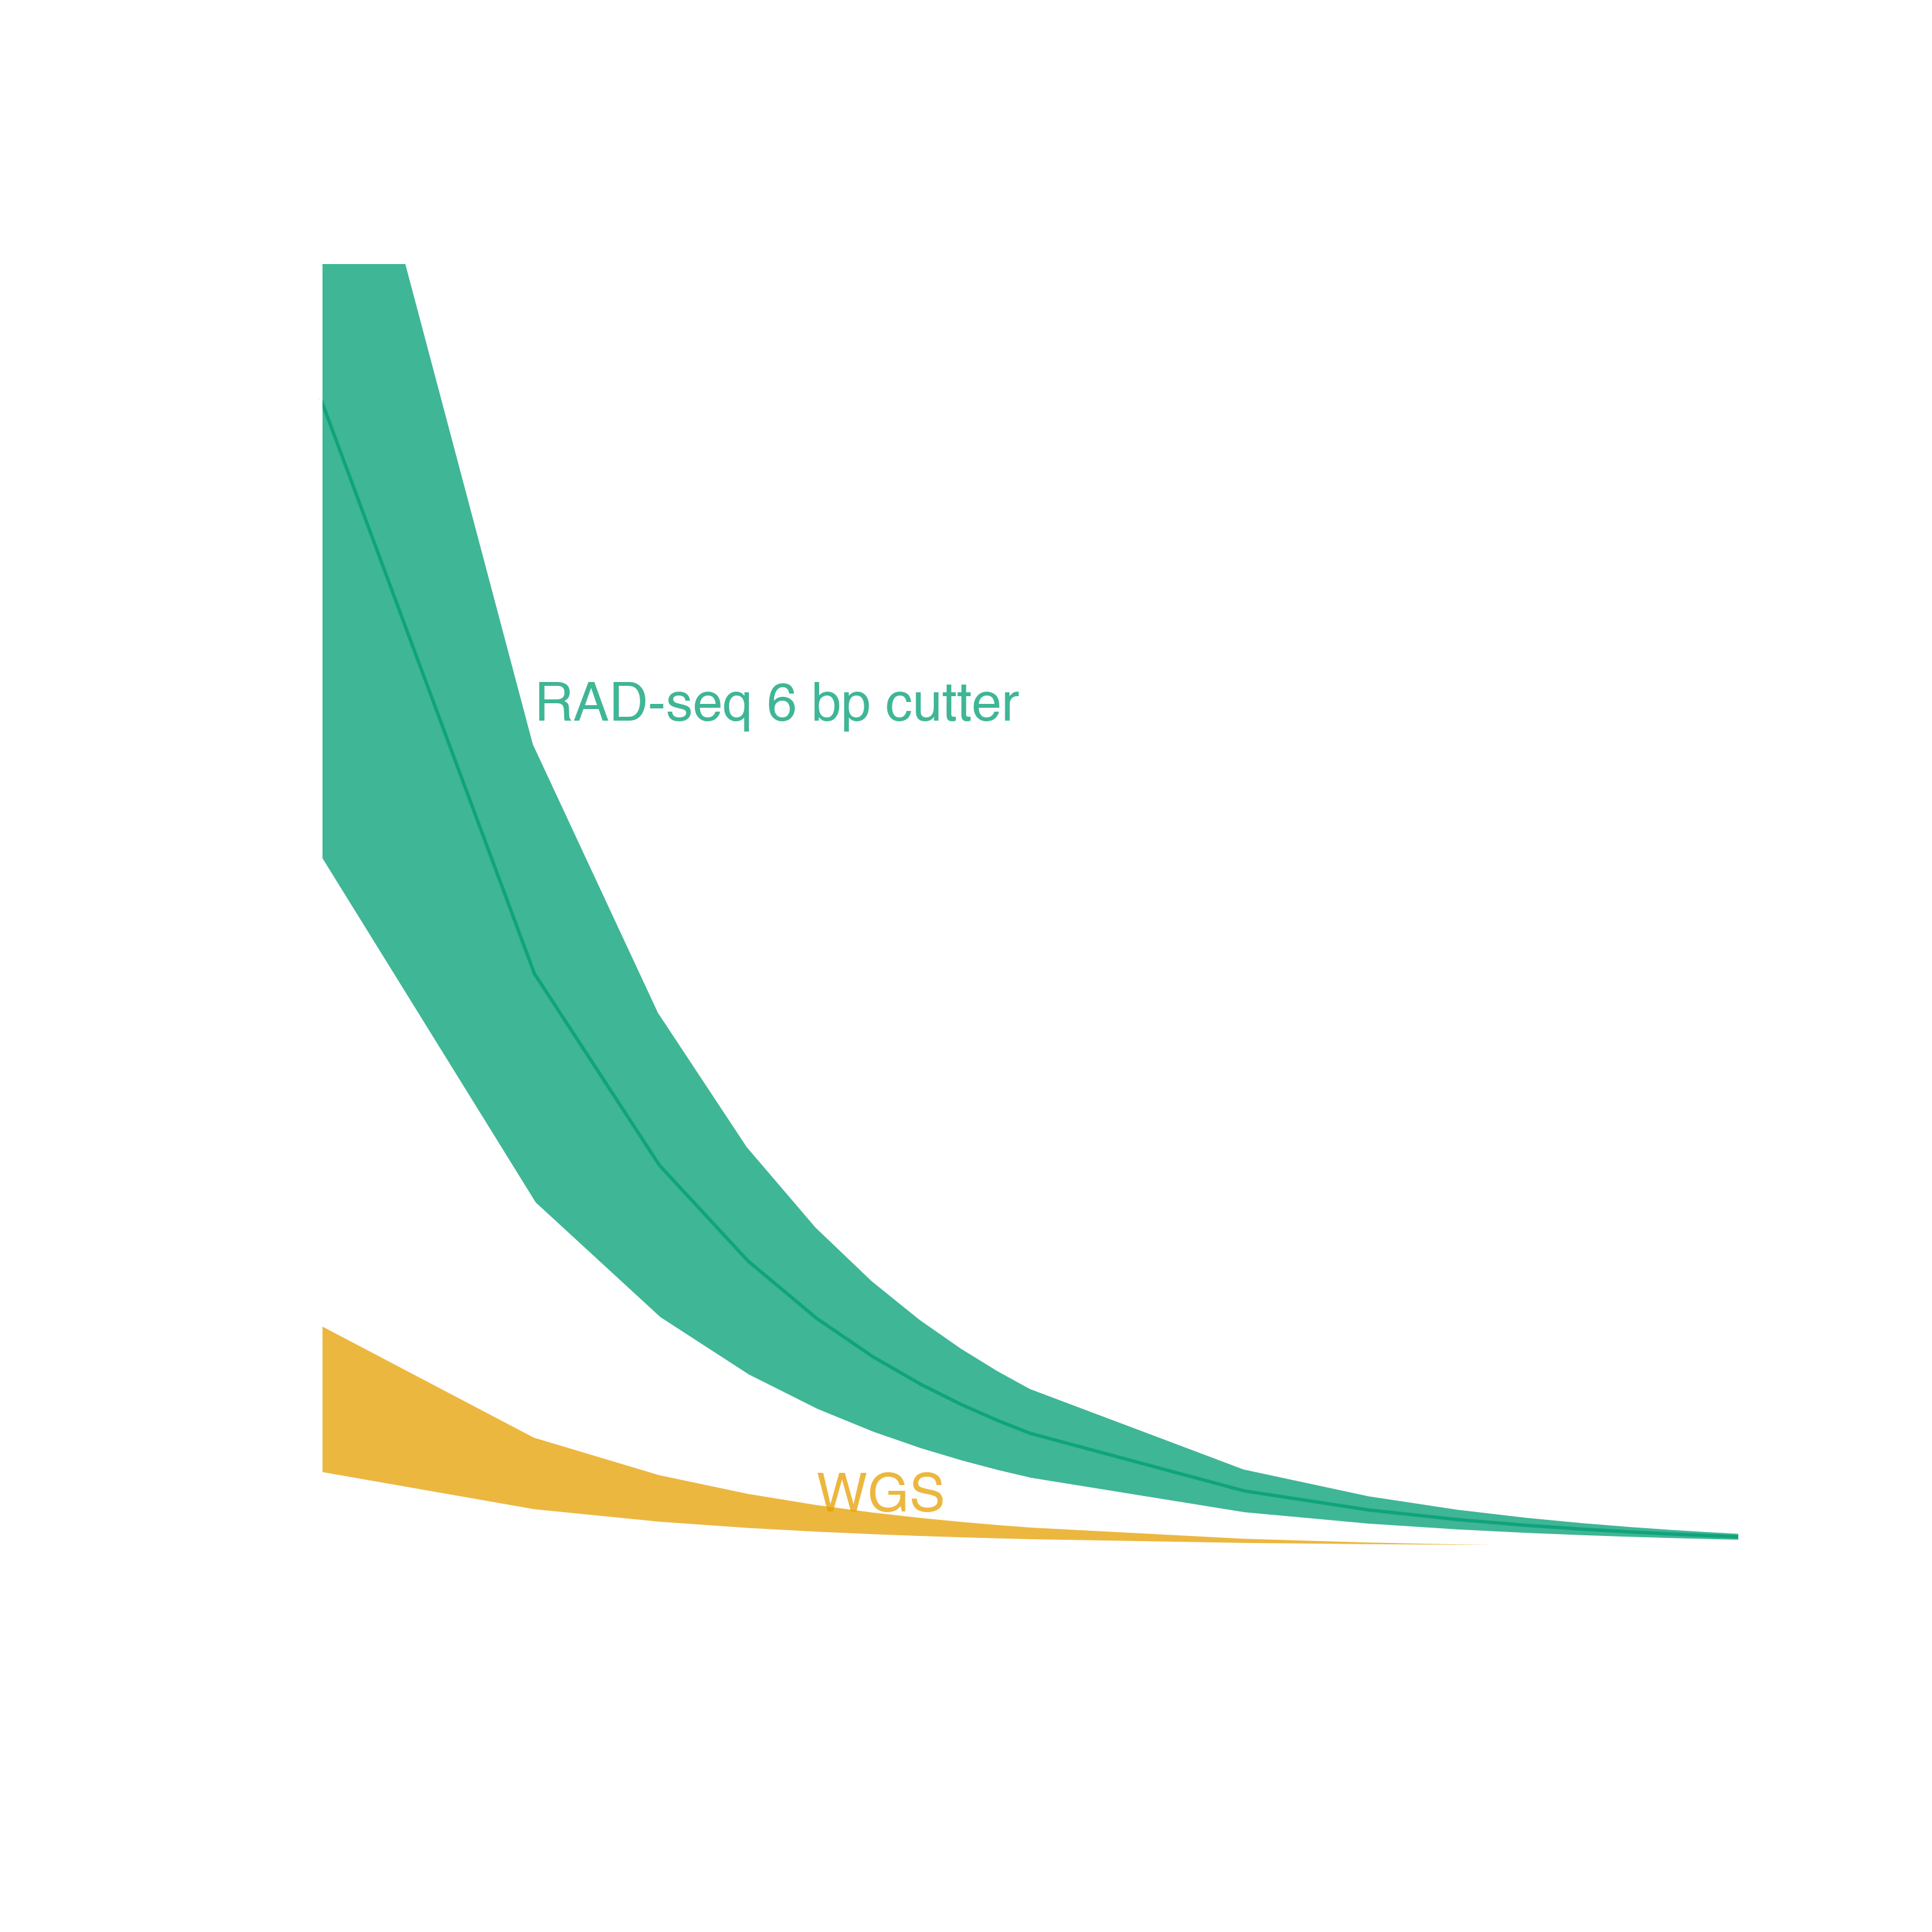
Genome reduction options
With genomic resources
WGS
Need an assembled genome
Relatively expensive, unless pooling
Exome capture
Requires an annotated transcriptome at minimum, better with annotated genome
Requires synthesized probes
Adapted from Lowry et al. 2016
B@G 2018

Slide 6

Traditional exome capture
Probes
Hybridize to DNA library
Capture
Wash, elute, PCR enrich
Sequence
B@G 2018

Slide 7
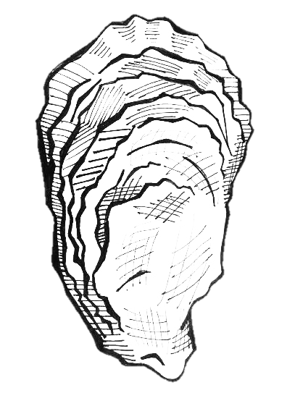
Expressed exome capture sequencing
Probes
Hybridize to DNA library
Capture
Wash, elute, PCR enrich
Sequence
B@G 2018

Slide 8
EecSeq
Use expressed mRNA to probe the exome
Remove the need for a previously sequenced transcriptome
Remove the cost and time associated with probe synthesis
EecSeq!
B@G 2018

Slide 9
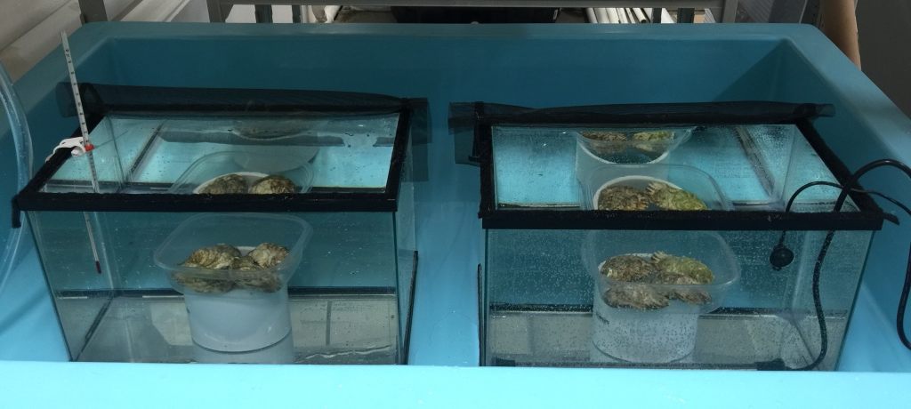
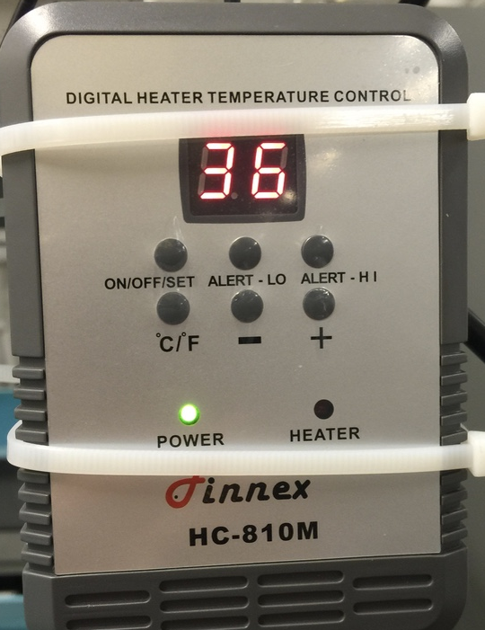
EecSeq: Proof of Concept
Simple heat shock exposure
4 exposed individuals at 36 ºC for 1 hour
4 control individuals at ambient (12 ºC for 1 hour)
B@G 2018

Slide 10

Control oysters
DNA extraction
RNA extraction
Exposed
oysters
Shotgun library preparation
mRNA library preparation
Exon loci
Custom Adapters
Hybridization
Genomic Library
Non-target loci does not hybridize
Adapter removal and biotin labeling
DSN Normalization
Non-target loci
Probe
Probes
Saved for transcriptome sequencing
Exome capture
Biotin
Streptavidin bead
Exon loci
Wash and elution
PCR
Enrichment
Exome sequencing

Slide 11
Sequencing
6 replicate captures of 8 individuals
Original probes
Original probes plus 12 additional rounds of PCR
~48% of reads mapping to exons
B@G 2018

Slide 12
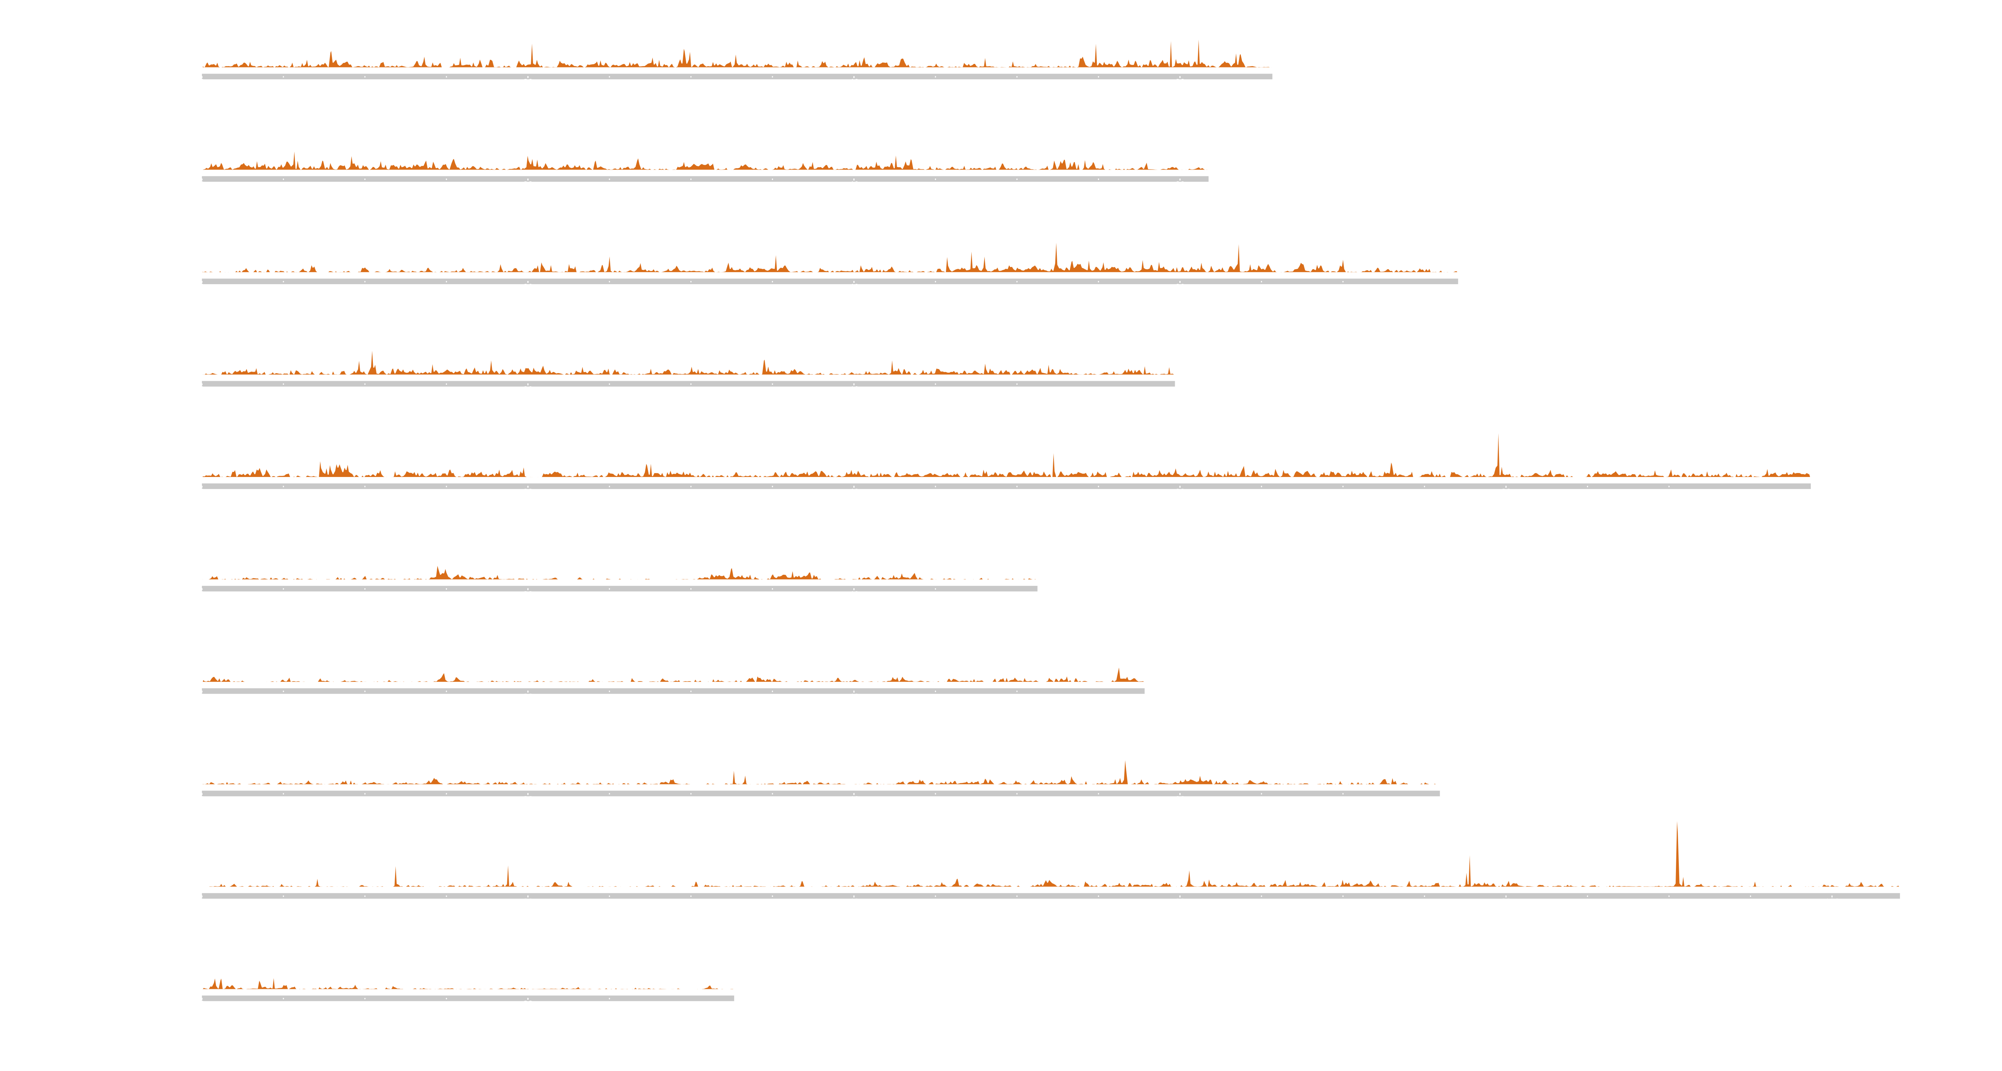
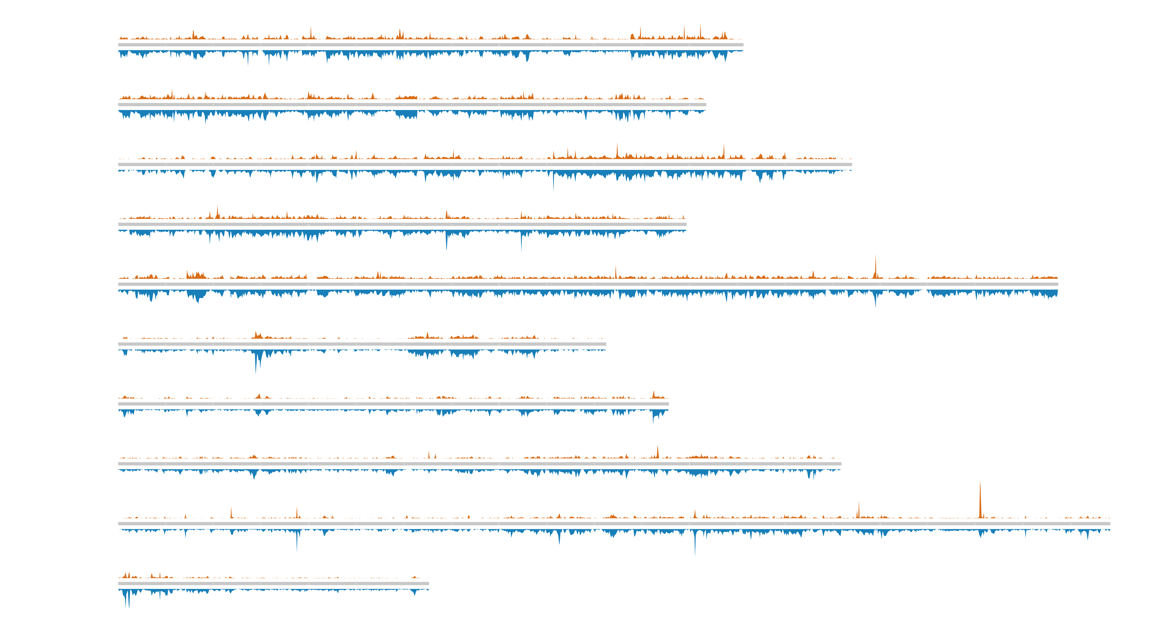

EecSeq targets expressed exons
B@G 2018

Slide 13


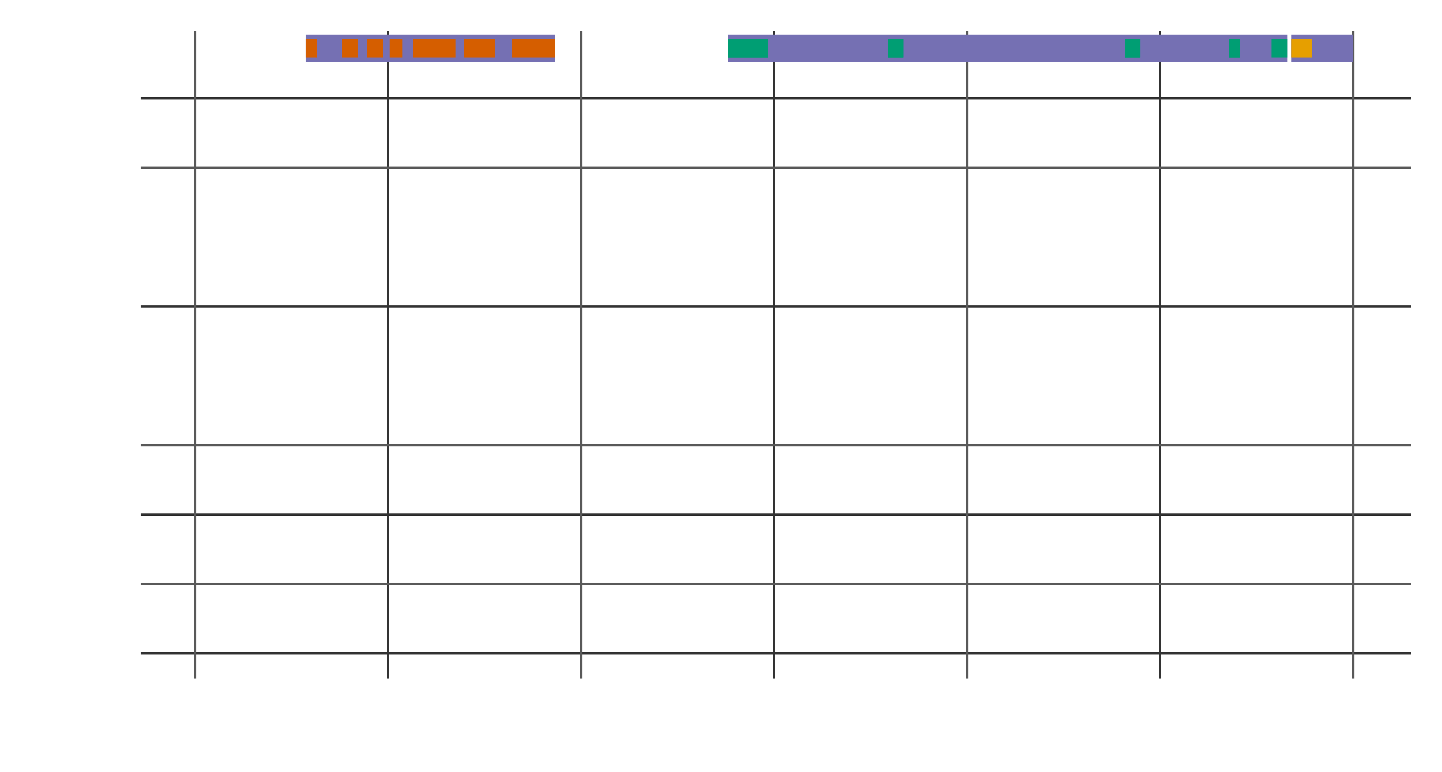
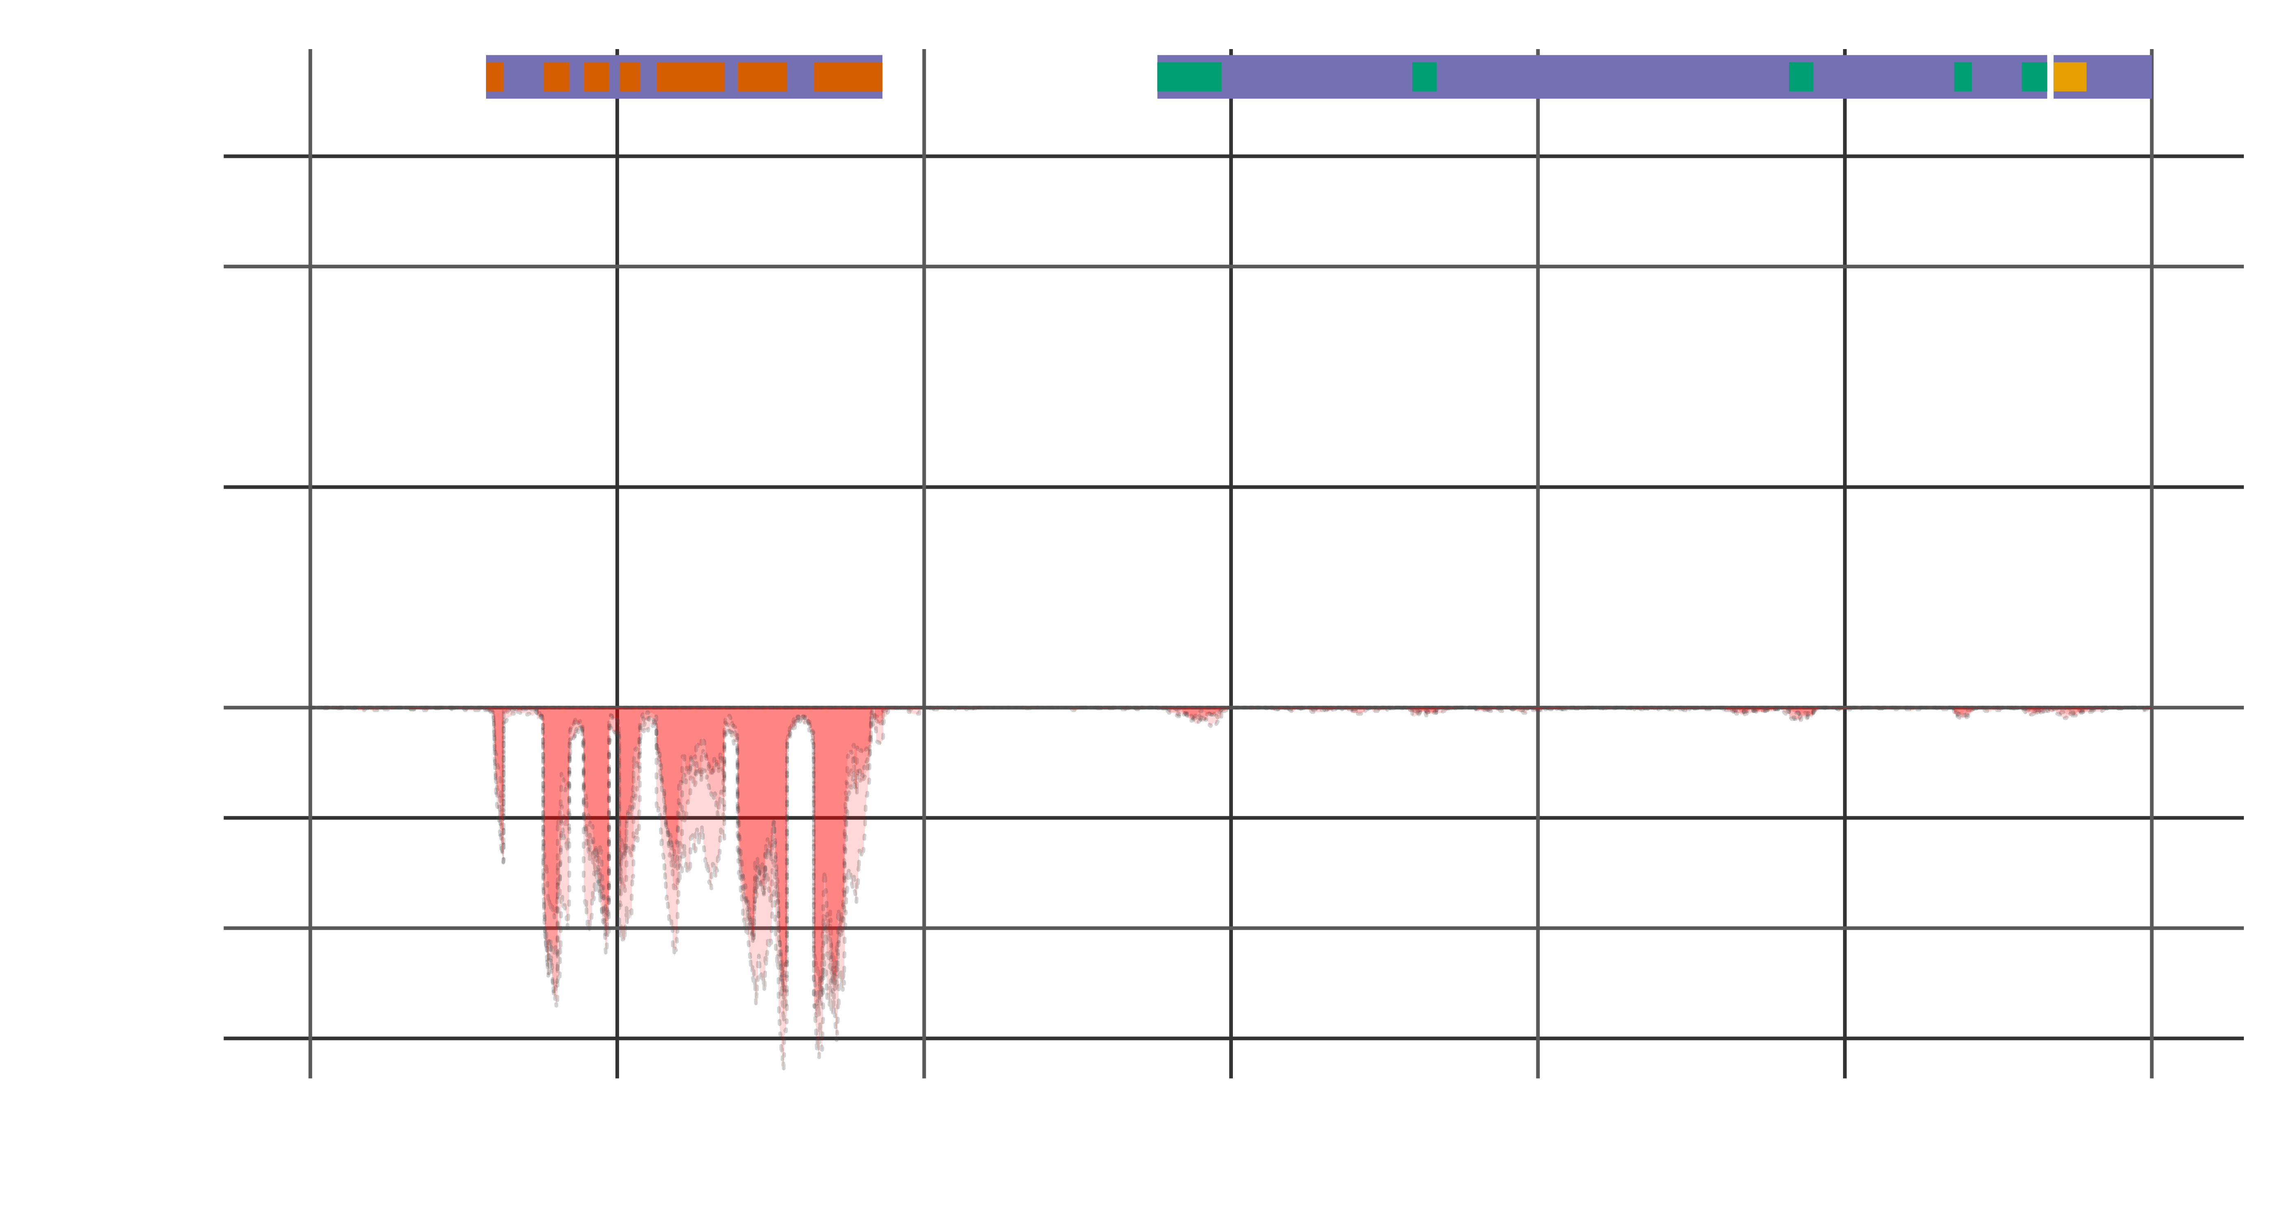

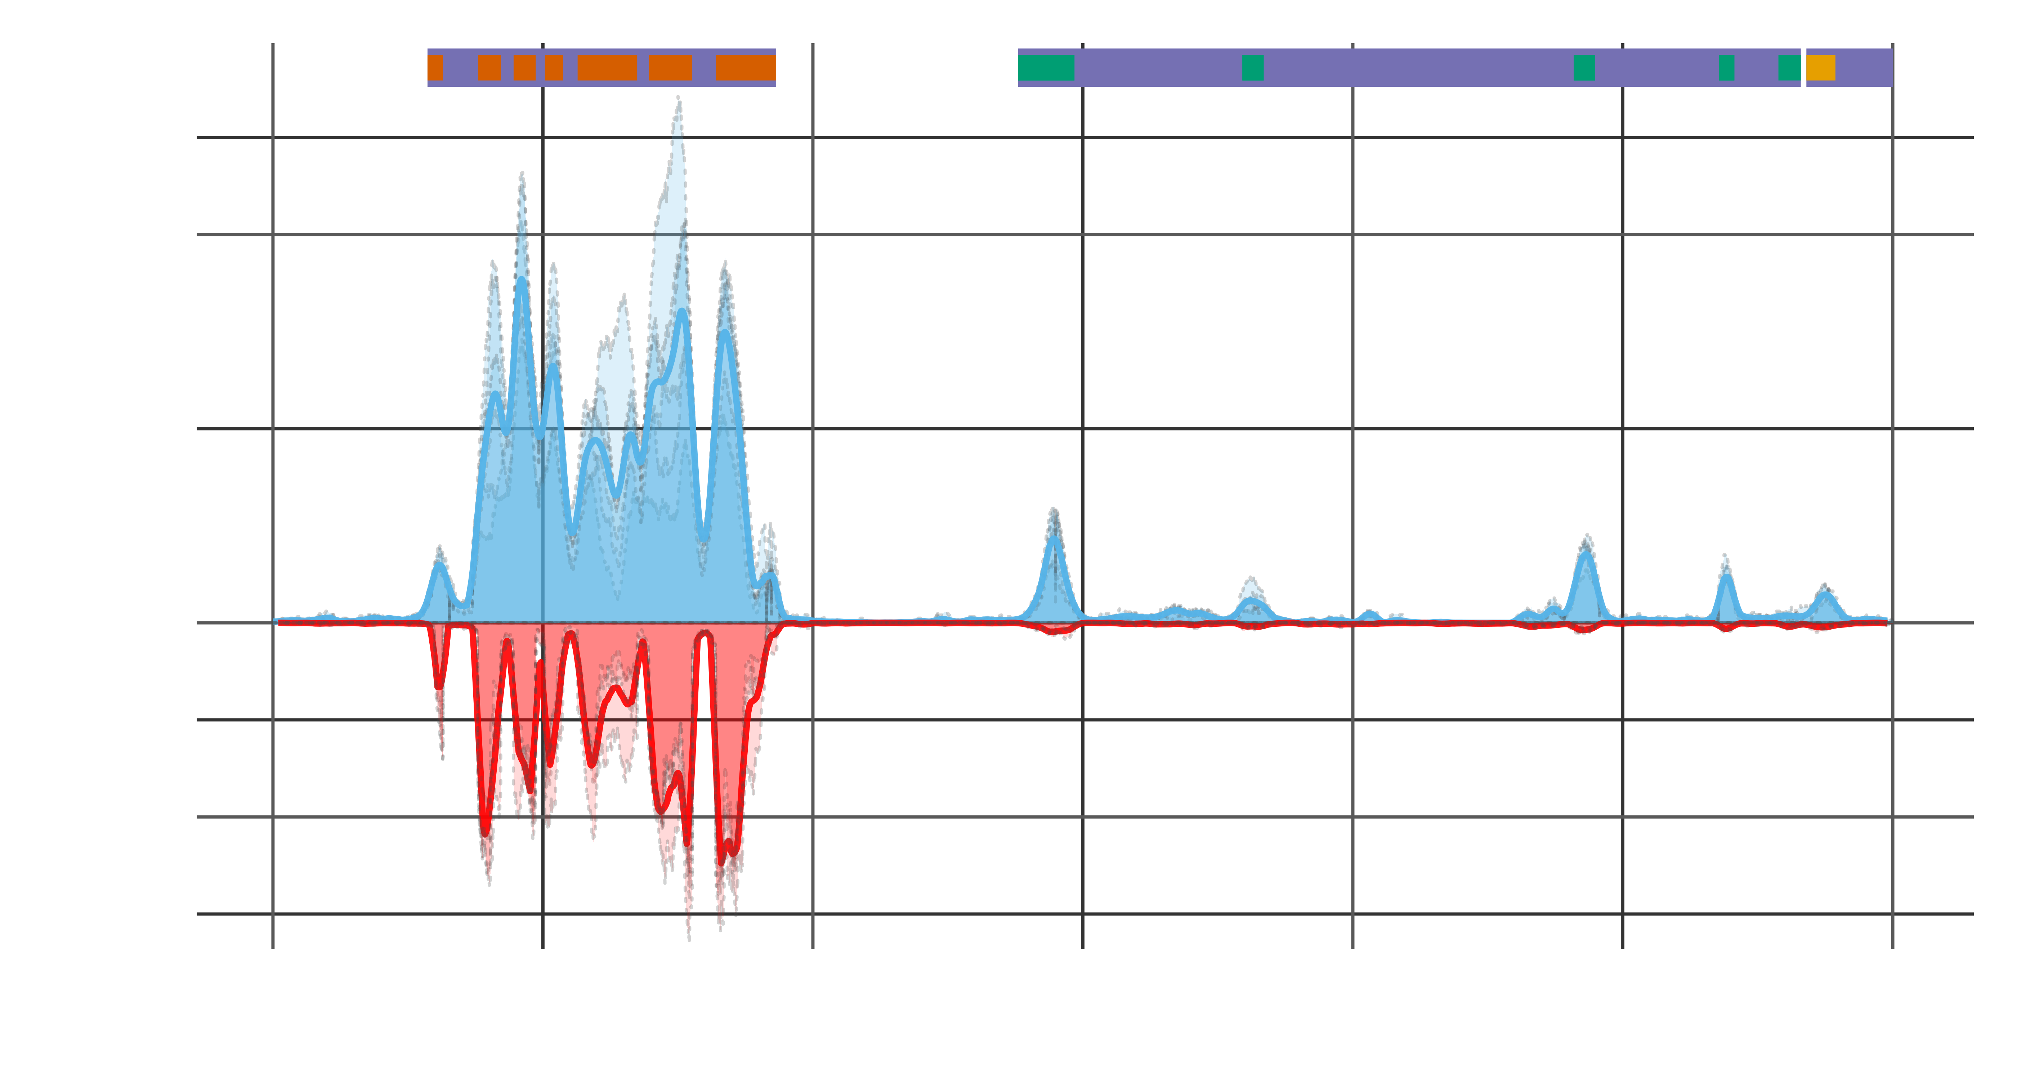
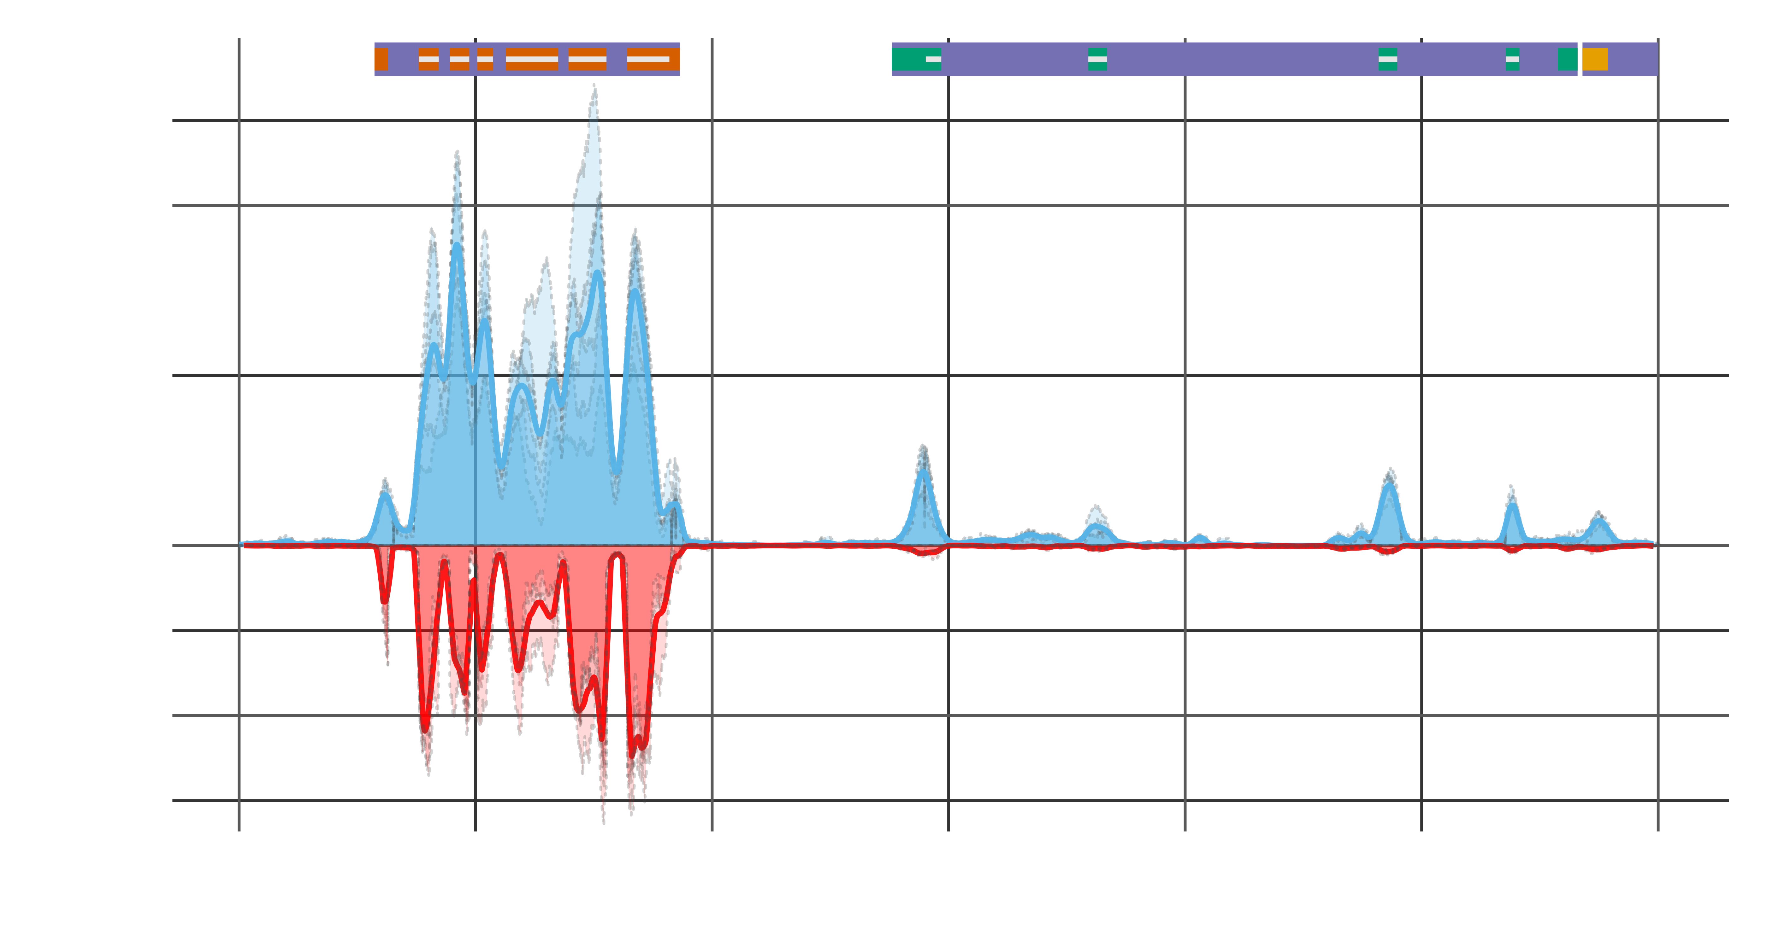
EecSeq targets expressed exons
B@G 2018

Slide 14
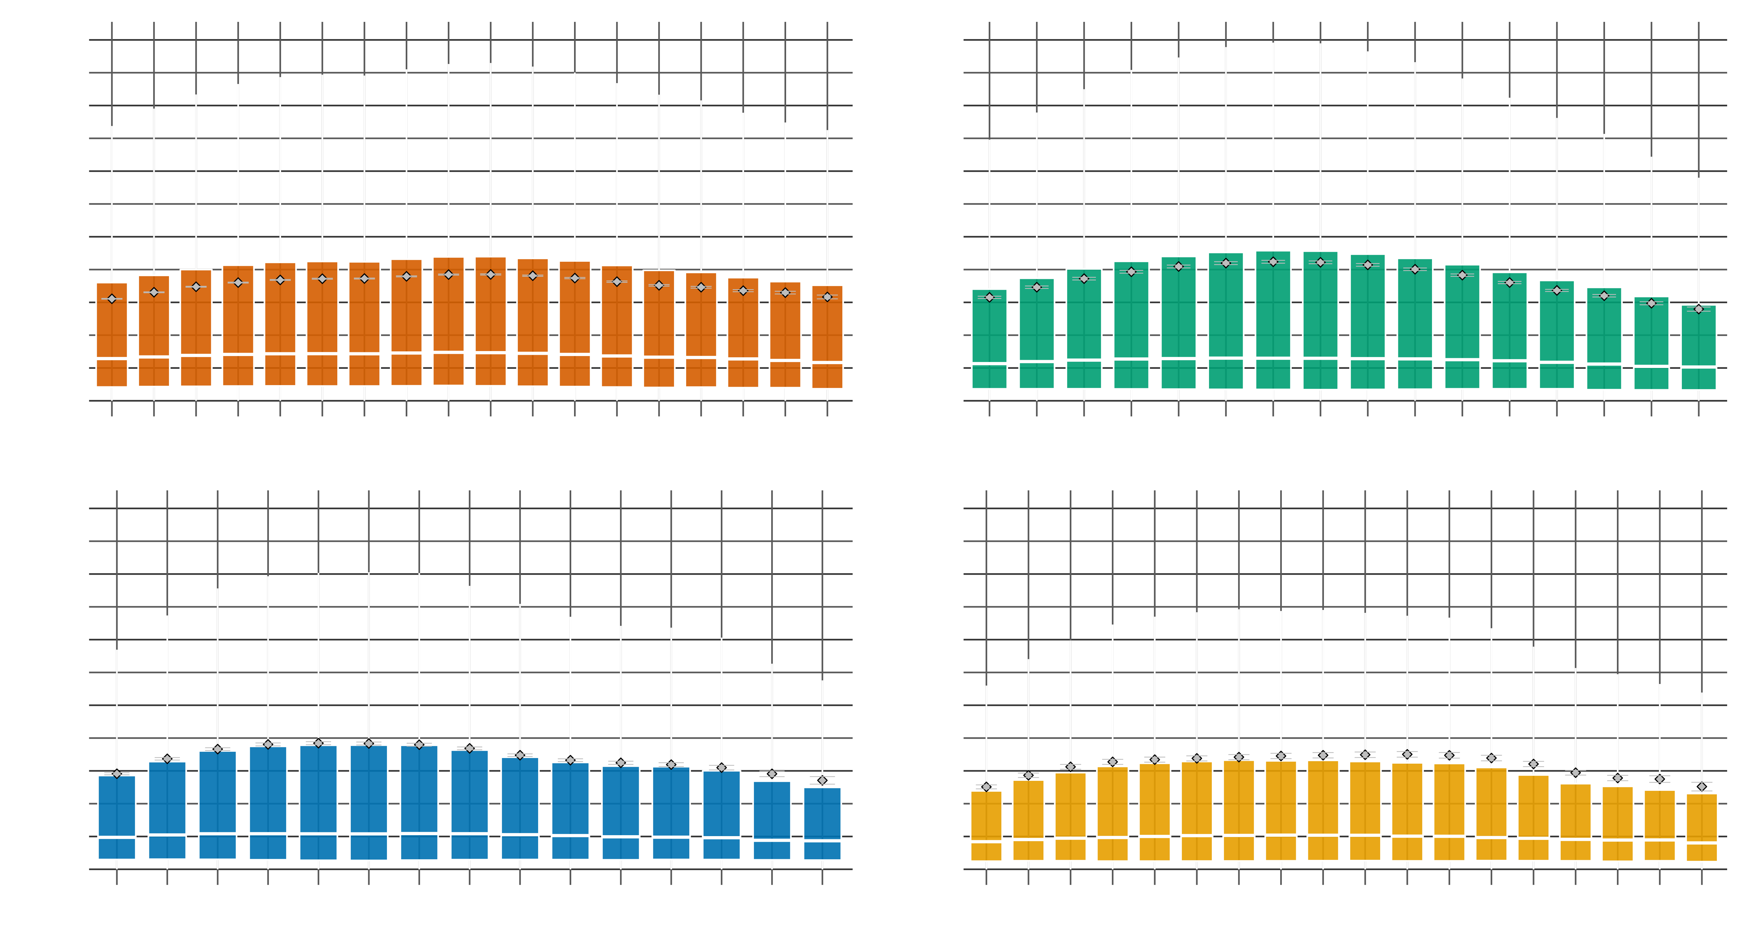
Edge Effects?
B@G 2018

Slide 15
Edge Effects?
B@G 2018

Slide 16
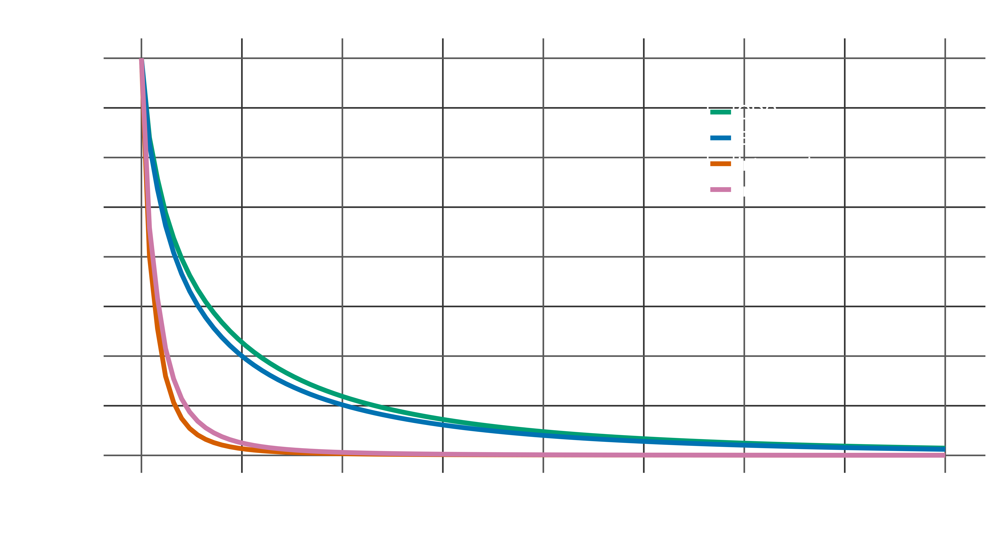
EecSeq Efficiency?
B@G 2018

Slide 17
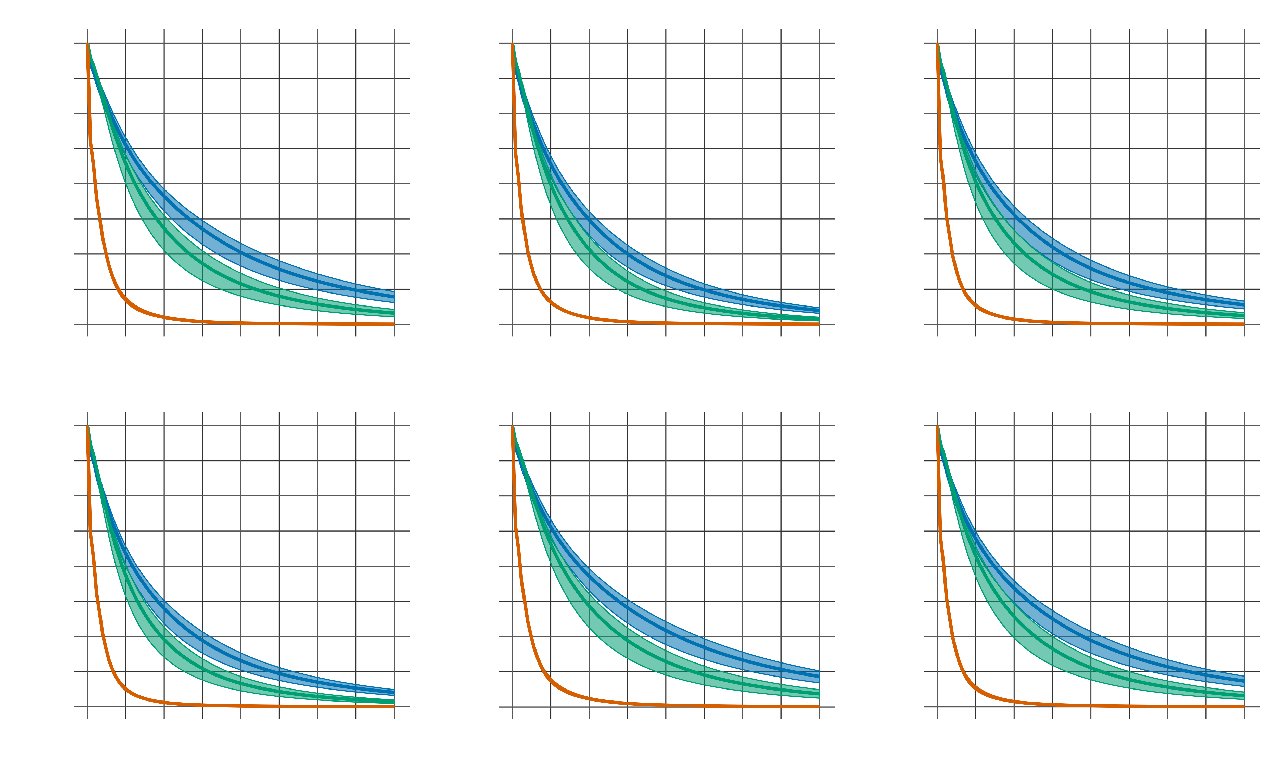
EecSeq capture efficiency
B@G 2018

Slide 18
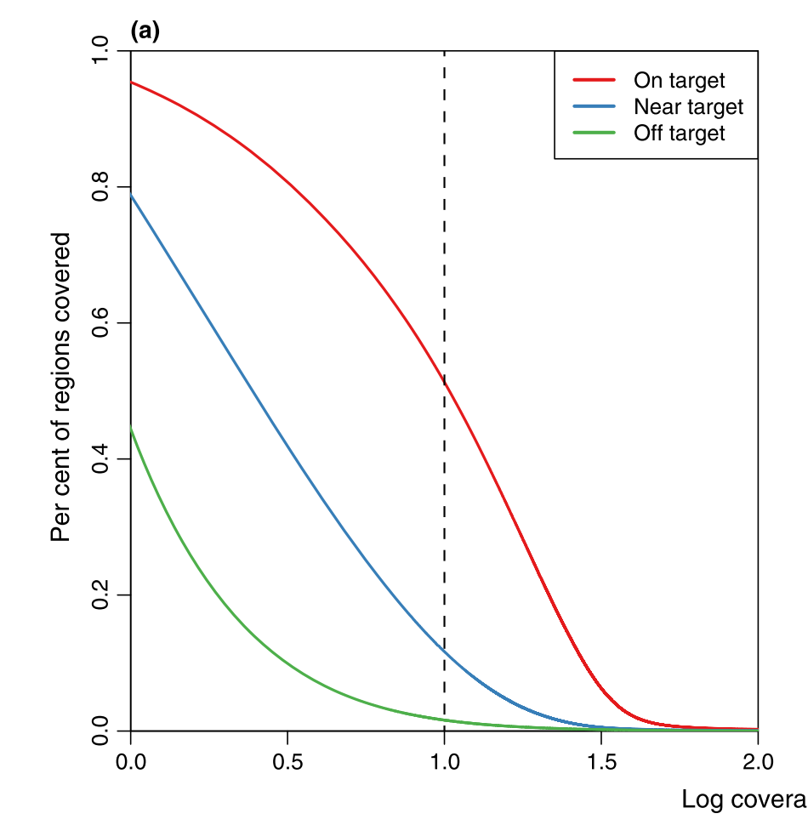
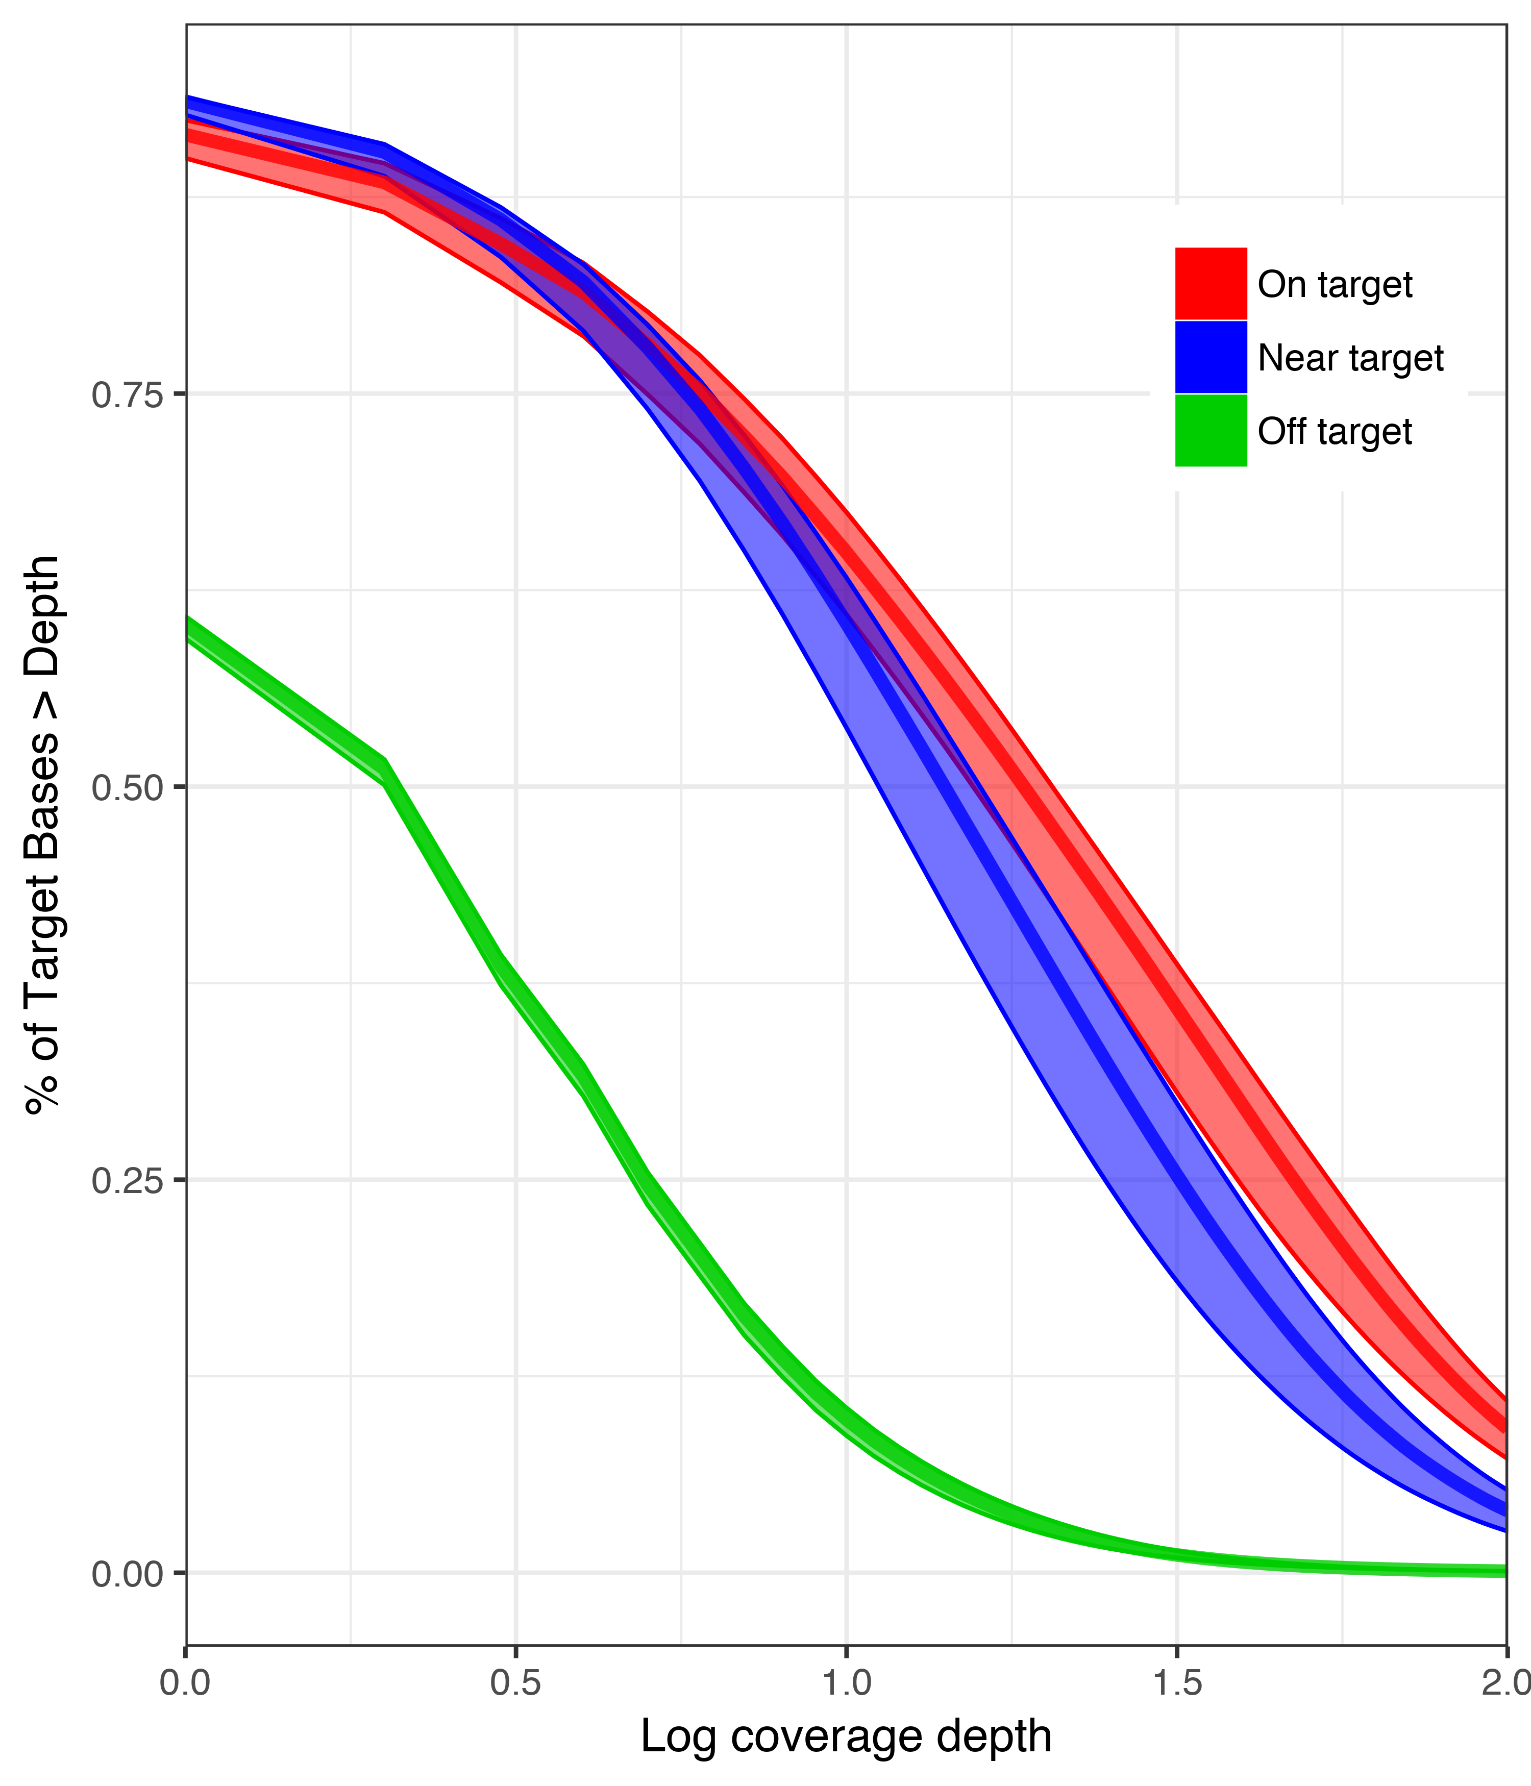
How does EecSeq compare?
Genome/Transcriptome derived
EecSeq
Log coverage depth
Suren et al. 2016
B@G 2018

Slide 19
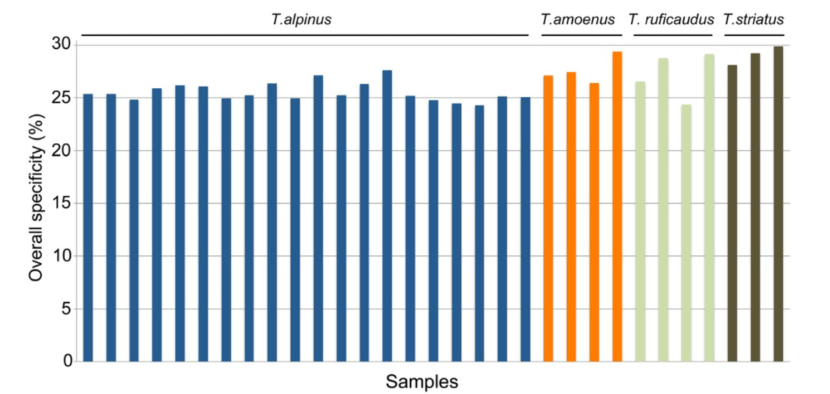
How does EecSeq Compare?
Transcriptome derived
EecSeq
Bi et al. 2012
B@G 2018

Slide 20
EecSeq SNPs
Total SNPs | 909,792
B@G 2018

Slide 21
EecSeq SNPs
Total SNPs | 909,792
Exome SNPs | 99,169
B@G 2018

Slide 22
EecSeq SNPs
Total SNPs | 909,792
Exome SNPs | 99,169
48X Exome SNPs | 8,837
B@G 2018

Slide 23
EecSeq SNPs
Total SNPs | 909,792
Exome SNPs | 99,169
48X Exome SNPs | 8,837
80X Exome SNPs | 3,508
B@G 2018

Slide 24
Take home messages
Expressed exome capture sequencing (EecSeq):
Targets expressed exons
Delivers consistent and efficient exome enrichment
Is comparable to traditional methods of exome capture
Generates thousands of exome SNPs cost effectively
B@G 2018

Slide 25
Future directions and feedback
De novo bioinformatics pipeline
Adapter redesign and updated protocol
Second proof of concept experiment
Feedback
Collaborators with synthesized probes to directly compare
B@G 2018

Slide 26
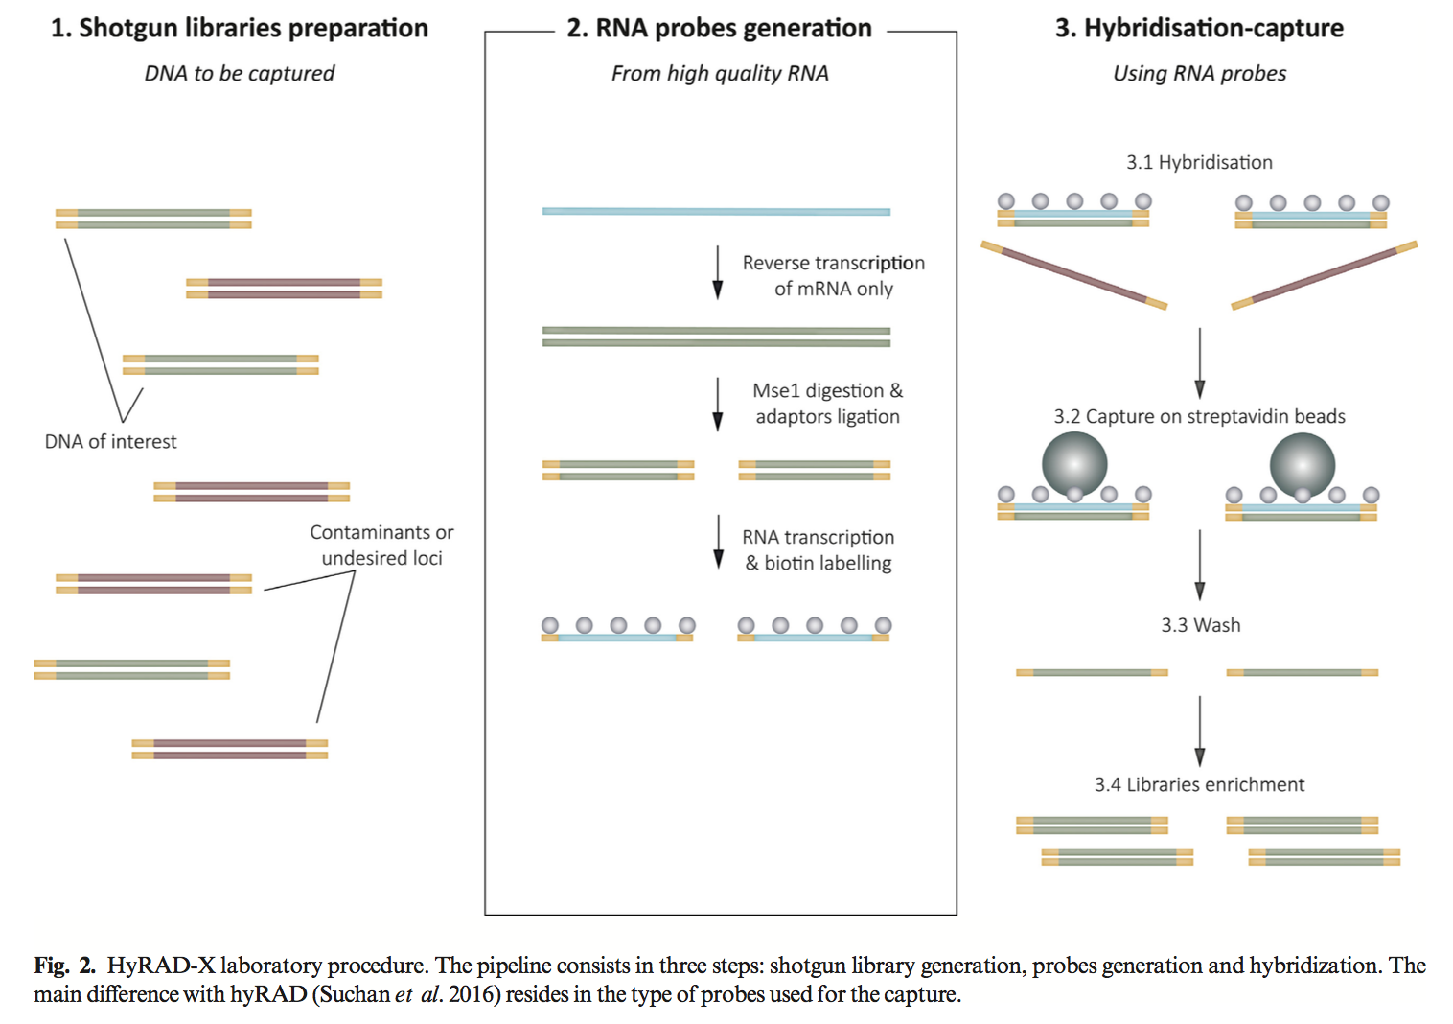
What about hyRAD-X
HyRAD-X
524 SNPS
EecSeq
28,144
3,289 (80X)
Schmid et al. 2017

